Slide 1
Alzheimer’s Disease Trends in the United States and Tennessee from 1999-2018
Capstone Project for Nashville Software School Data Analytics Cohort 2
John Posey
Data Analyst

Slide 2
Alzheimer’s Disease pathology and presentation
What Alzheimer’s Disease is?
how it affects those diagnosed?
how does the prolonged nature of the disease affect the healthcare system?

Slide 3

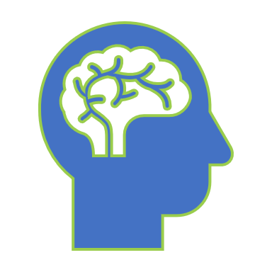
How does your Brain work?

Slide 4
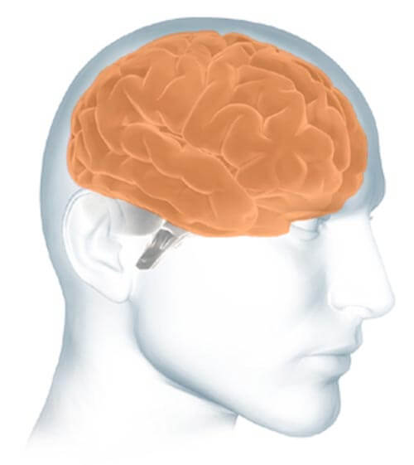
Parts of the Brain
The cerebrum fills up most of your skull. It is involved in remembering, problem solving, thinking, and feeling. It also controls movement.

Slide 5
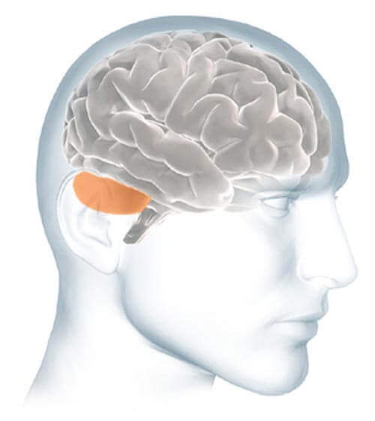
Parts of the Brain
The cerebellum sits at the back of your head, under the cerebrum. It controls coordination and balance.

Slide 6
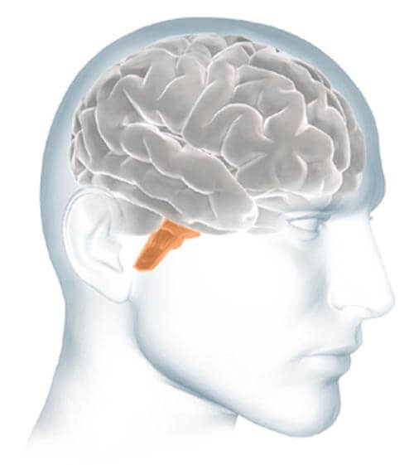
Parts of the Brain
The brain stem sits beneath your cerebrum in front of your cerebellum. It connects the brain to the spinal cord and controls automatic functions such as breathing, digestion, heart rate and blood pressure.

Slide 7
Alzheimer’s Disease, Brain Function, and Cognitive Decline
Ad’s effect on brain function and the resulting cognitive decline.

Slide 9
Overall Trend in the United States 1999-2018
Overall trend in AD–related deaths in the United States between 1999-2018.

Slide 11
Overall Trend in Tennessee 1999-2018
Overall trend in AD–related deaths in TEnnessee between 1999-2018.

Slide 13
Caregiving trends and overall statistics

Slide 15
What to do if someone you love has Alzheimer’s Disease?
A short guide for Family and friends

Slide 17
Resources
Links to various organizations and programs for help.

Slide 19
Bibliography
I would like to give credit to the following resources for the data that I used for this presentation.

